Slide 1
WP advanced topics
3.sem MMD

Slide 2
PHP

Slide 3
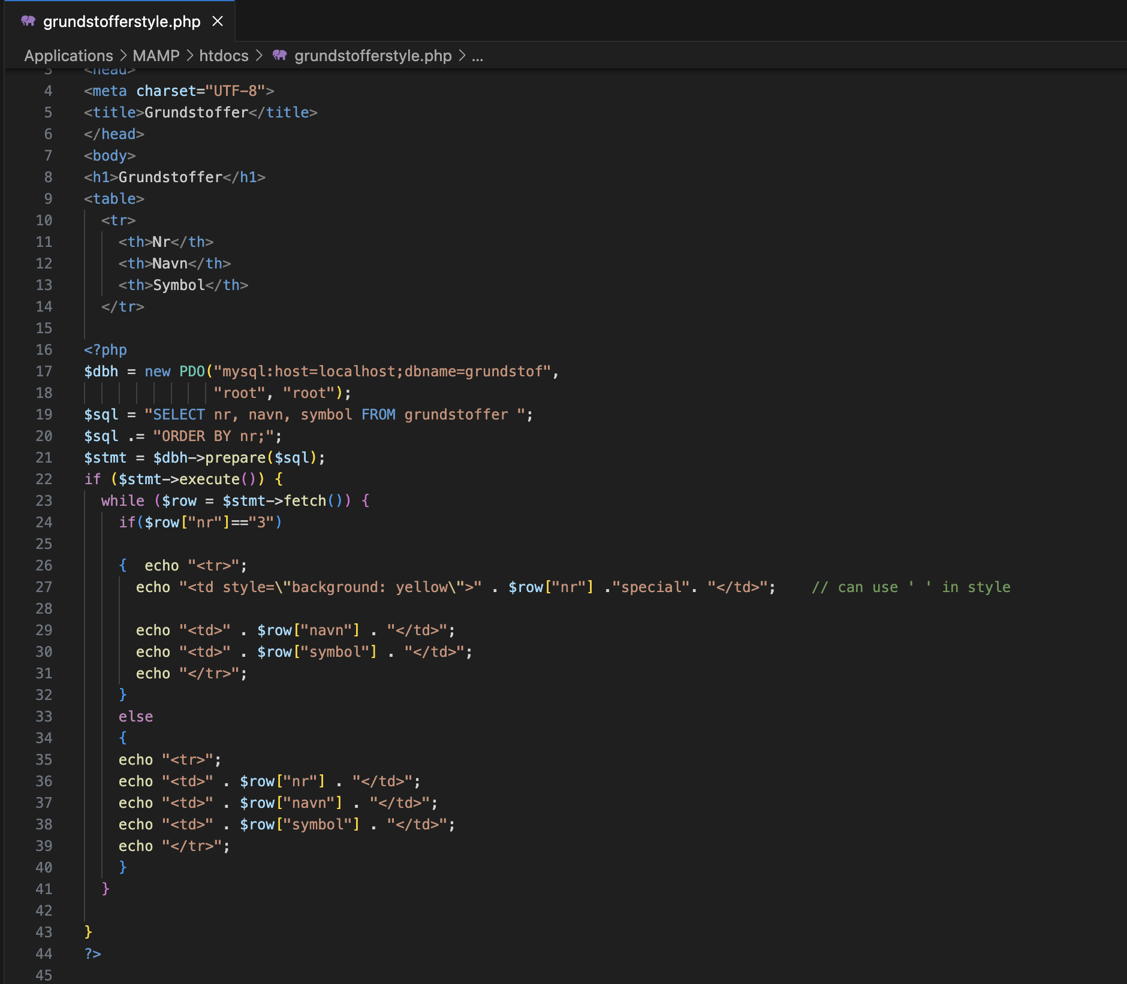
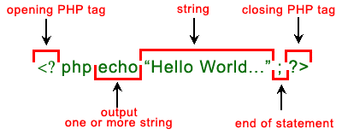
Syntax

Slide 4
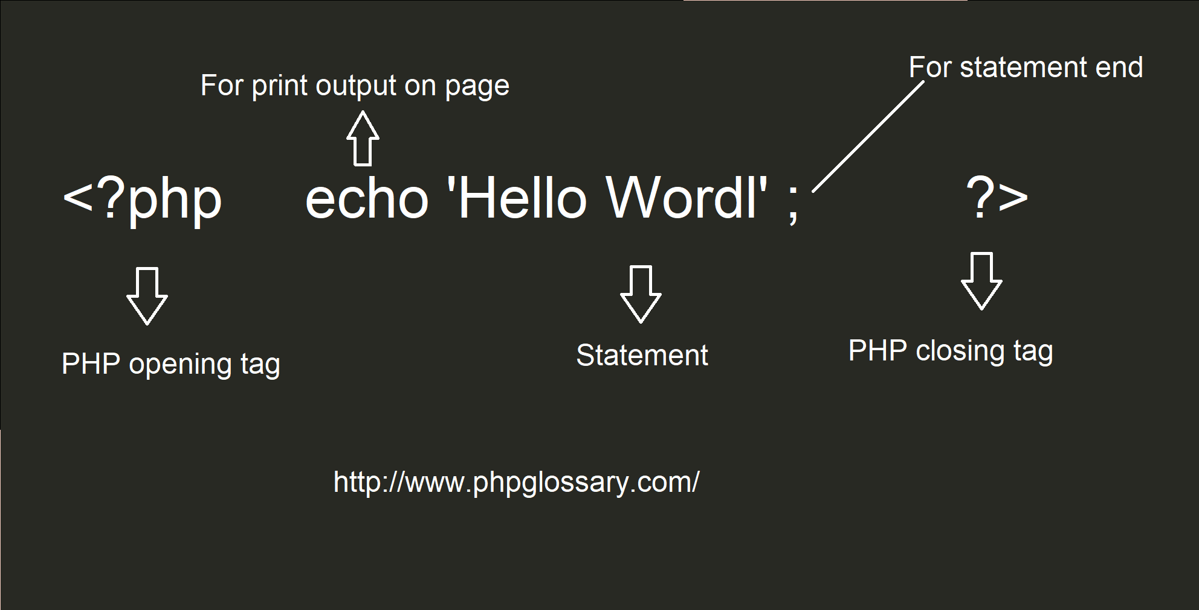
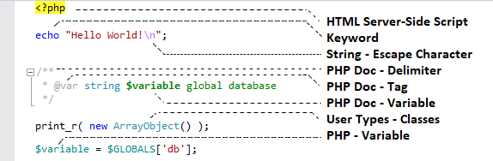

Slide 5
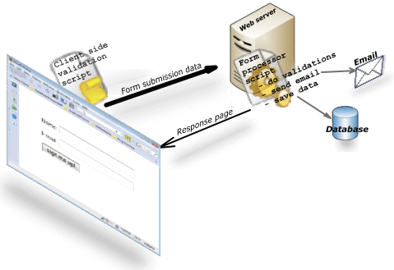
Source: https://www.javascript-coder.com/html-form/images/web-form-working1.png

Slide 6
Demo1 Server Side PHP & DB

Slide 7
WP

Slide 8
Scaffolding 3 themes

Slide 9
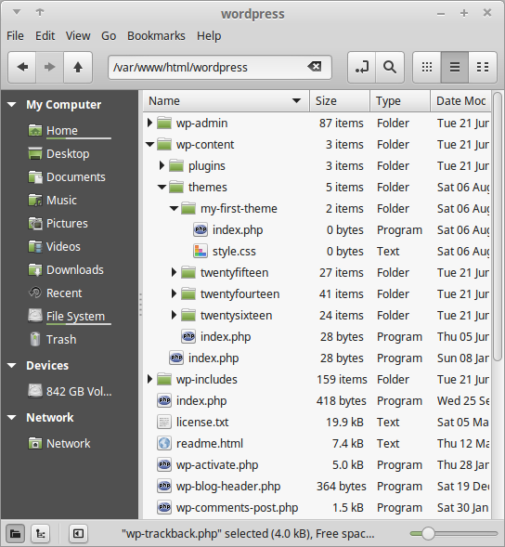
My very first theme
Make a folder inside our themes folder: /wp-content/themes/my-first-theme
Inside our new theme folder we will create 2 files:
index.php
style.css
Let us review the template structure from last time
NOTES:
Do not use space , uppercase or other special characters when naming your theme folder.

Slide 10
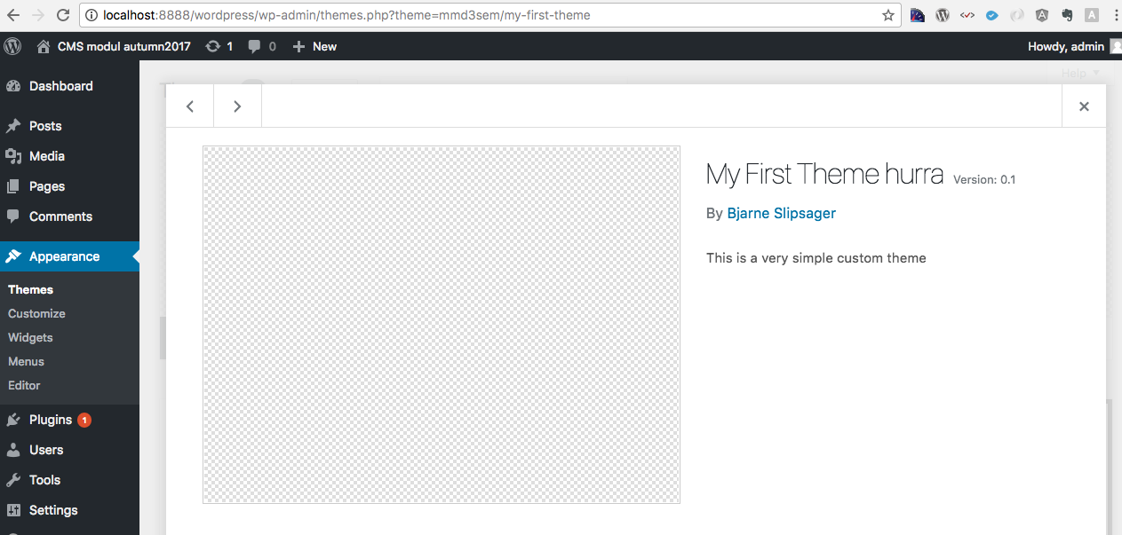
Let us give it some descriptions
style.css
/* Theme Name: My First Theme Author: XBI Author URI:
Description: My first theme, it is really cool. Version: 1.0
License: GNU General Public License v3
*/
https://codex.wordpress.org/Theme_Development#Theme_Stylesheet

Slide 11
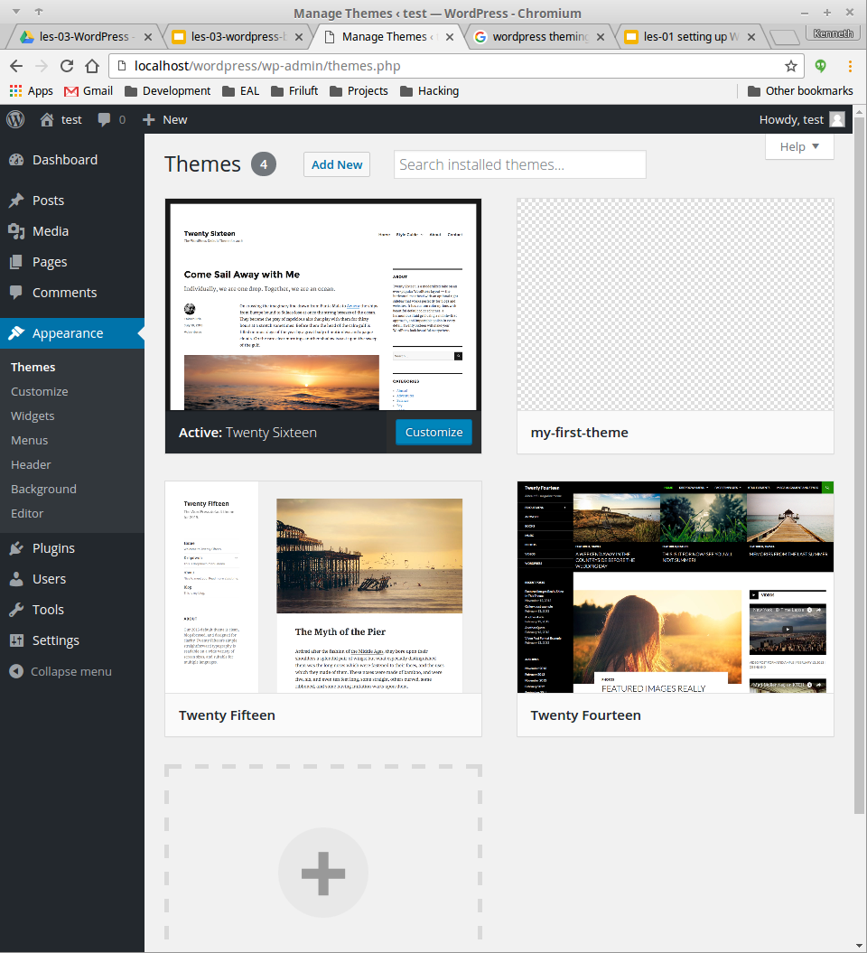
Our new theme
To see if your theme works go to: http://localhost:8888/wordpress/wp-admin
and login.
Then in the left menu click on Appearance > Themes.
The my-first-theme should show up.

Slide 12
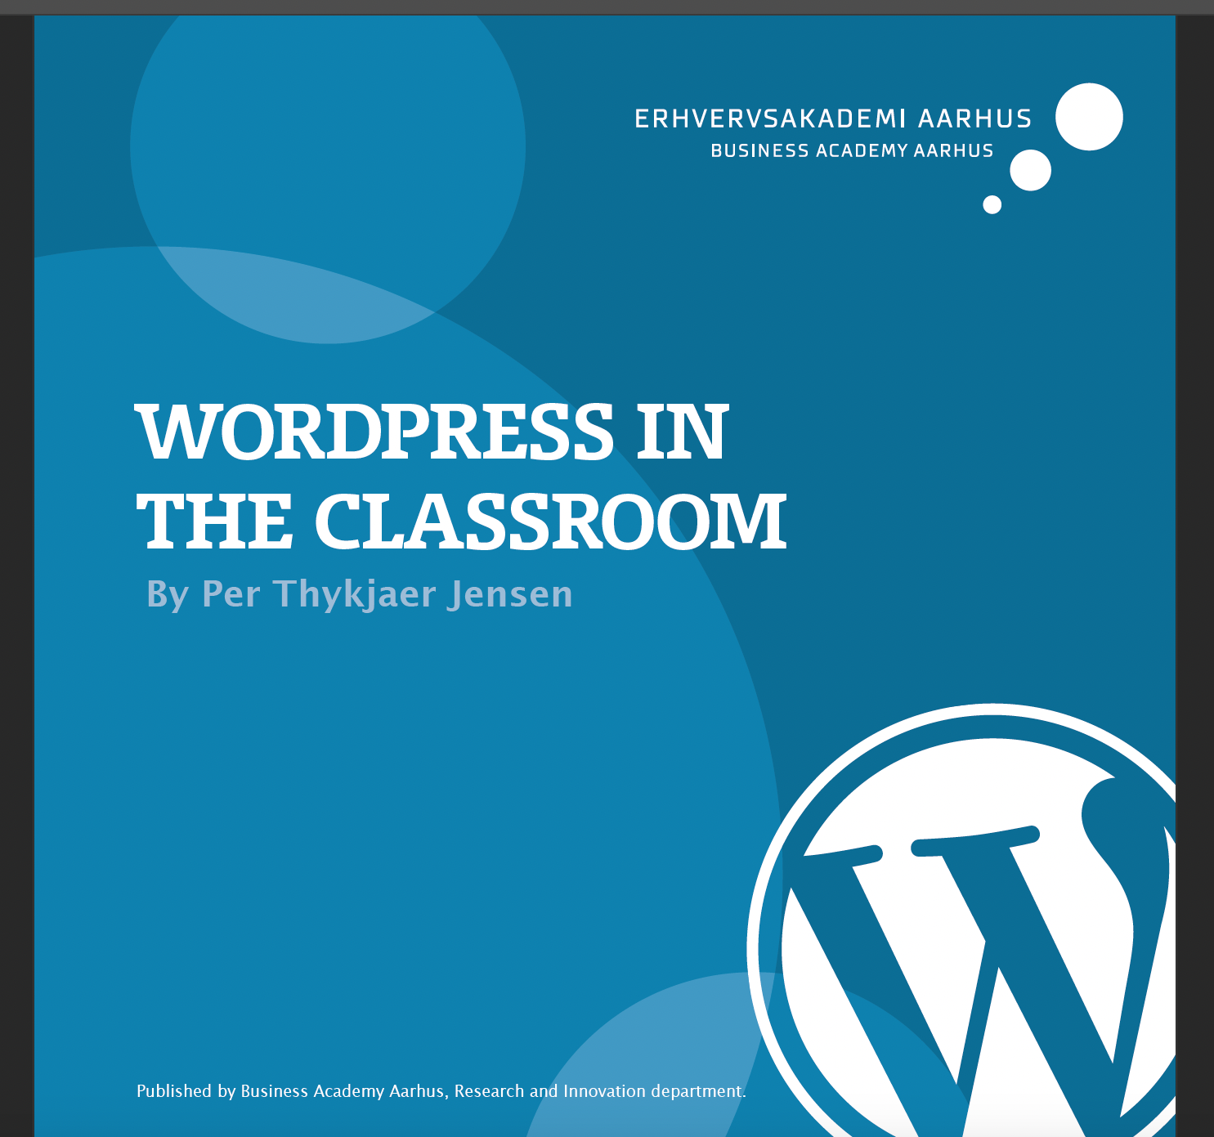
Download 3 themes- side 52
https://ipaper.ipapercms.dk/ErhvervsakademiAarhus/Forskningsrapportguides/wordpress-in-the-classroom/

Slide 13
30 min Exercise –explian how is the theme developed?

Slide 14
WP Content model
Content kan være: Posts, Pages med også Products, Movies, Opskrifter….
Content modelling minder om database modellering
Content types i CMS har Fields (attributter) og Relations
“CMS might be considered a “super database,” by which we mean a database extended to offer functionality specific to managing content”
Notes:
Andre elementer i kap.6 Darker
Fields/attributes and datatypes (Text, Number, Date, Time,Gmap location)
Attribute validation: Hvor stor skal billedet være? Hvad er et valid mobilnummer? regular expression
Metadata (
Content embedding
WordPress, for instance, has something it calls “Shortcodes,” which are text snippets
that are processed during output. For example:
[photo_gallery folder="images/2015-christmas-party"]
https://speckyboy.com/getting-started-with-wordpress-shortcodes-examples/
Blocks and widgets
Drupal has extensive functionality for “blocks,” which can be added to regions on a
template. Likewise, WordPress offers “widgets” that can be stacked into specific
regions on the template (see Figure 6-11).
Relationship

Slide 15
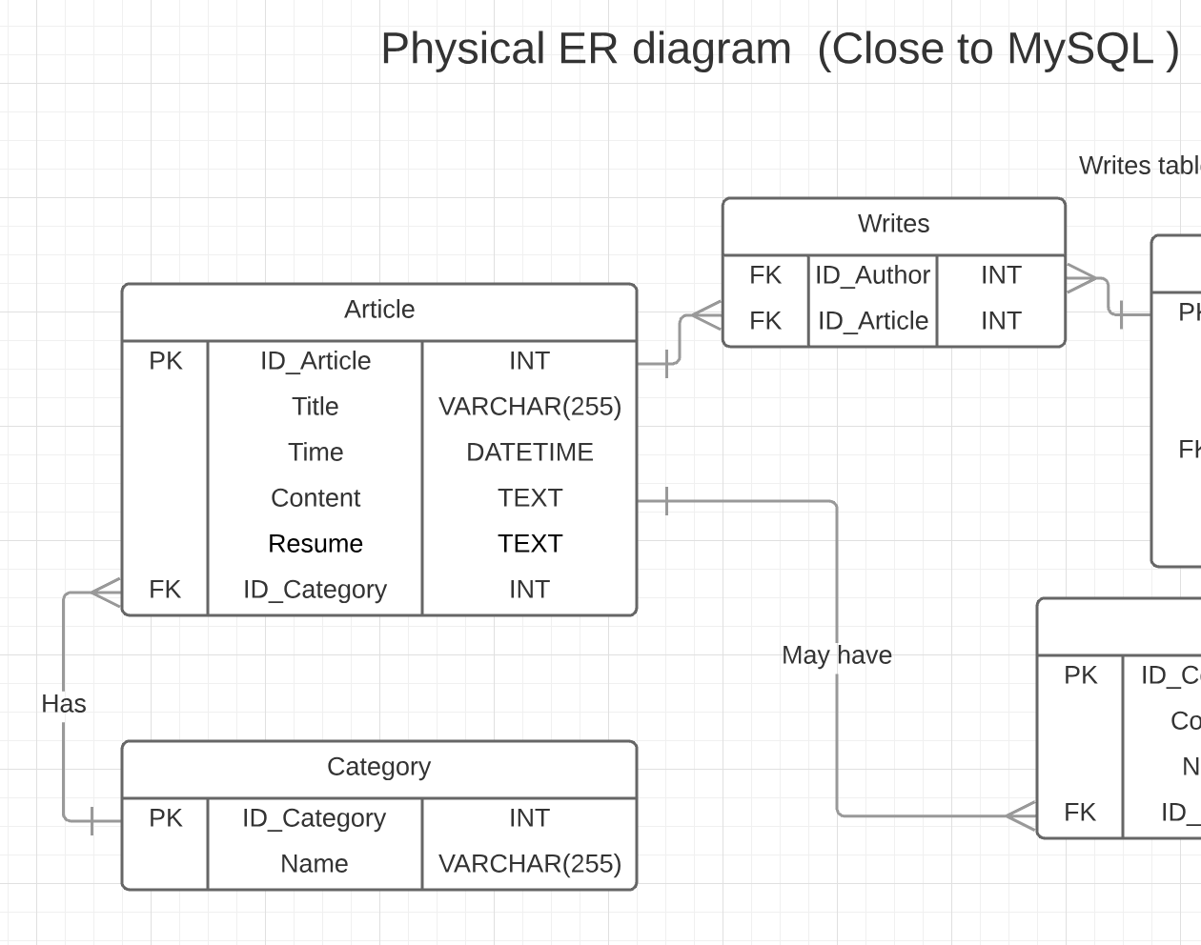
Article/Post content type
Posts i WP har: Fields:
id, title, content, date, time, excerpt
Relationships:
Author, Category, Tags, Revision

Slide 16
Post types in WP
Posttype: Post The posts for the blog.
Posttype: Page A text page representing specific page content.
Menu items
Attachment Images, media
Revision (versionering)
Custom post types Product, Recipe, Place,
Post types represent different types of content models (Entities ).
All content (post types) is stored in wp_posts table in the database.
This is the correct way of store all content in a WordPress website.
https://developer.wordpress.org/themes/basics/post-types/

Slide 17
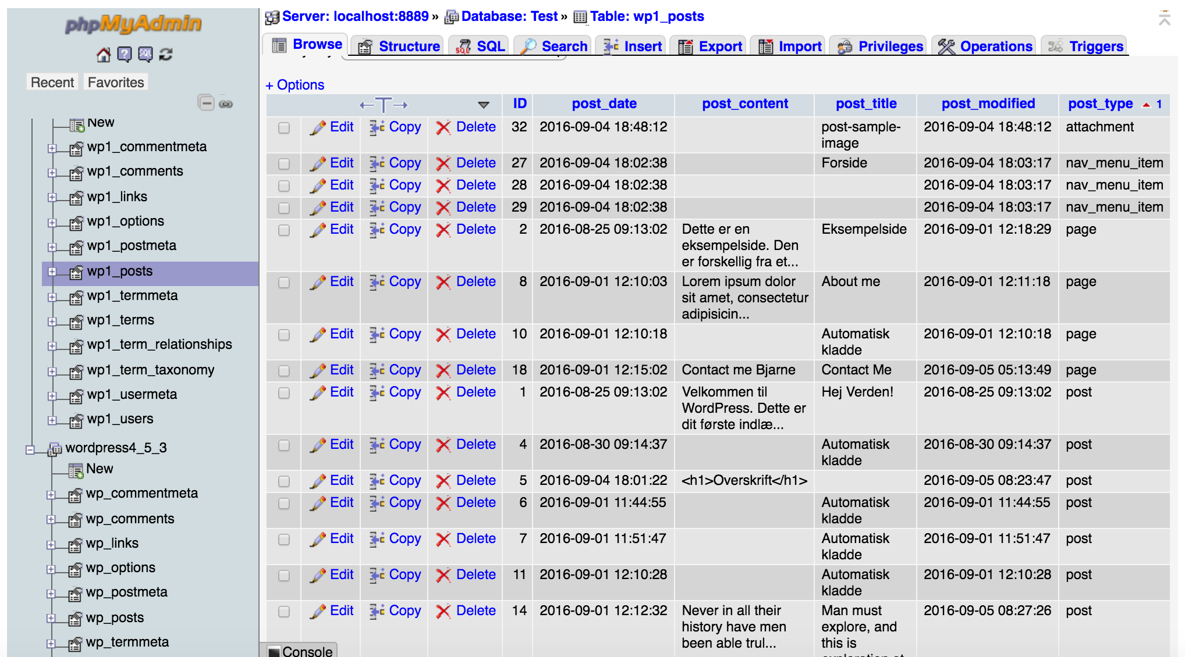
Content stored in the database

Slide 18
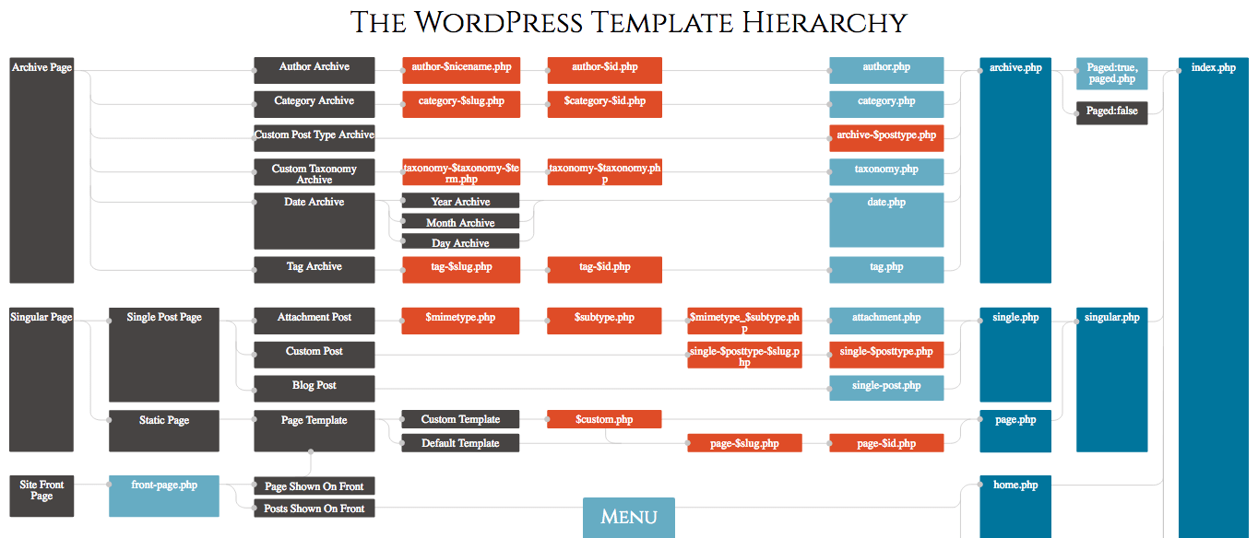
https://ipaper.ipapercms.dk/ErhvervsakademiAarhus/Forskningsrapportguides/wordpress-in-the-classroom/?page=76

Slide 19
More to learn...
https://www.linkedin.com/learning/wordpress-advanced-custom-fields
https://www.linkedin.com/learning/wordpress-development-coding-practice

Slide 20
Nye I WP
Block theme

Slide 21
More topics
Make your own plugins

